Slide 1
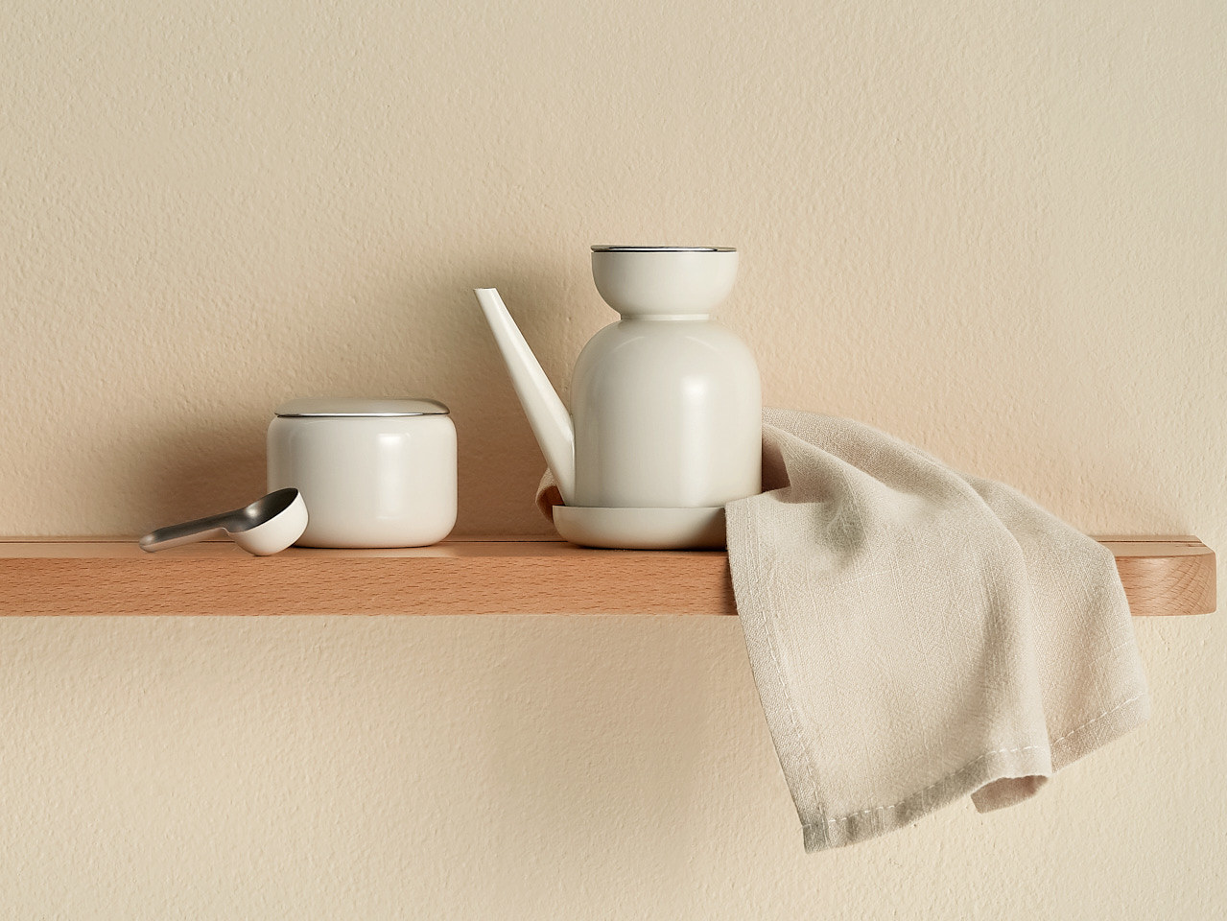
higher Design & Manufacture
Evaluation Techniques

Slide 2


Learning intentions & success criteria
Learning Intentions
Developing my evaluation and analysis skills
Success Criteria
Explain why we evaluate products
Describe and select the appropriate methods for evaluating a product

Slide 3

What is product evaluation?
Evaluation goes on all the time.
Often we are carrying out evaluations and we do not even realise it.
We evaluate lots of different things and for lots of different reasons.

Slide 4

Why do we evaluate?
We evaluate all the time.
We evaluate in different ways but why do we do it?
  We evaluate so we can give feedback on how someone is progressing.
  We evaluate so we can give feedback on performance.
  We feedback so we can tell people how to make things better, how to make improvements.

Slide 5

Always evaluating
Any time we look at a product we evaluate it.
We judge products based on how they function, how attractive they are and how easy they are to use.
As designers we want our products to be successful and we have to make sure they are viewed in a positive light by consumers.

Slide 6
The criteria
When we evaluate a product we base our assessment on the design factors.
We can evaluate a product based on its…
  Function
  Performance
  Aesthetics
  Ergonomics
  Market
  Materials
  Safety
  Maintenance
  Processes

Slide 7

Evaluation strategies
Evaluation is all about analysing a product.
We want to find out what is good about it and what needs to be improved.
The main techniques we use to evaluate:
  User Trial
  Test Rig
  Product Placement
  Questionnaire/Survey
  Concept Testing
  Expert Testing

Slide 8
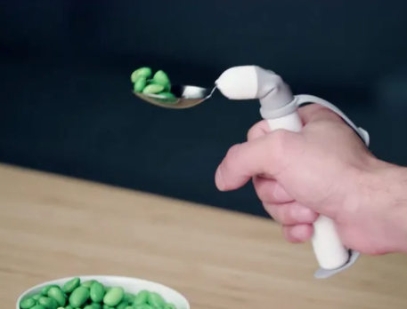
User trials
A user trial requires a potential users to physically use the product being evaluated.
User trials are carried out as short experiments aimed at evaluating specific aspects of the product.
For example, users might be asked to insert batteries into a camera or remote control.
Once the user has completed the task they will give feedback on their experience of using the product.

Slide 9
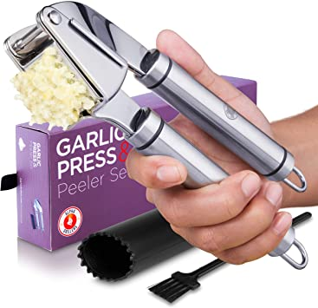
User trials
User trials make use of the thoughts and opinions of users after they have had the opportunity to use a product.
User trials can be used to identify issues relating to ease of use/maintenance, performance and ergonomics that designers might not have found.

Slide 10
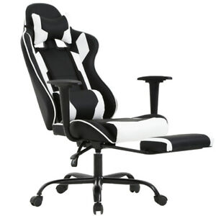
Evaluation strategies: user trials
A User Trial is used to measure issues such as
  Ease of Use
  Ease of Maintenance
  Ergonomic Factors
  Comfort
  Grip
  Sizes
  Accessibility

Slide 11
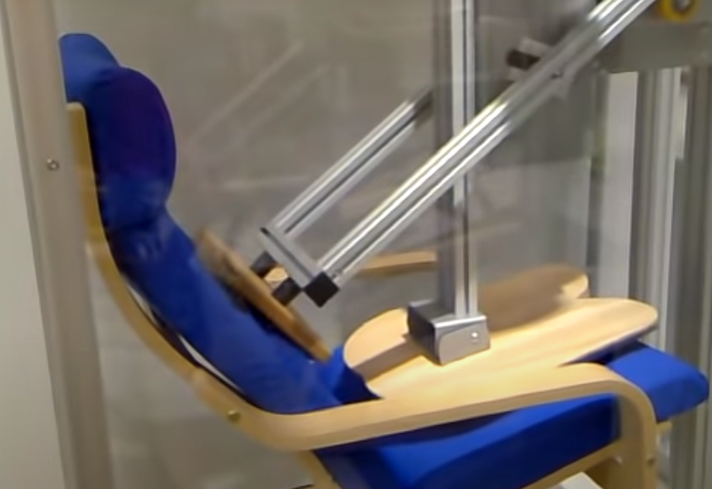
Test rigs
Product tests are carried out like experiments.
Carried out by designers, sometimes in a controlled environment, test rigs are created to measure performance, reliability and durability.
Often test rigs will test the product to its limits and beyond.
Testing may also involve using the products in unconventional ways to assess just how durable it is.

Slide 12
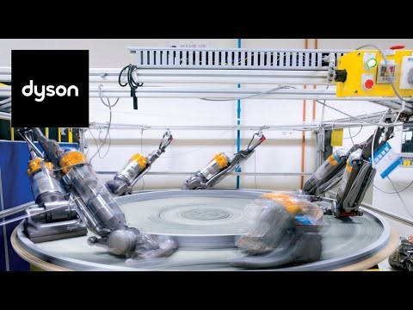
Test rigs
Test Rigs are designed to measure performance issues such as:
  Durability
  Reliability
  Wear and Tear
A Test rig can test a product 24 hours a day, 7 days a week for months at a time.
This would all be controlled by and recorded by a computer.
WATH THE DYSON TEST RIGS VIDEO
https://www.youtube.com/watch?v=F2YurW2Dn4A

Slide 13

2016 Samsung effect
So what happens when it all goes wrong?
This was a major blow for Samsung.
What is the impact of such an event on an electronics manufacturer?
https://www.bbc.co.uk/news/technology-37605948

Slide 14
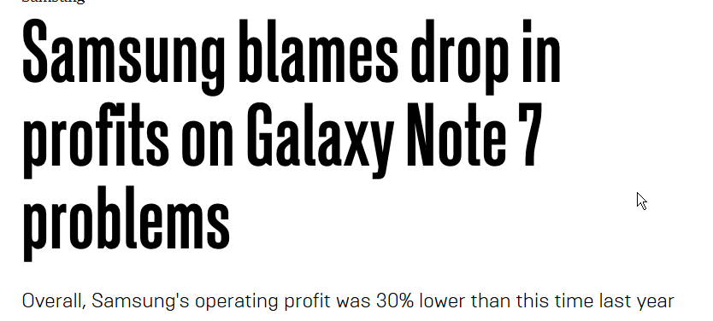
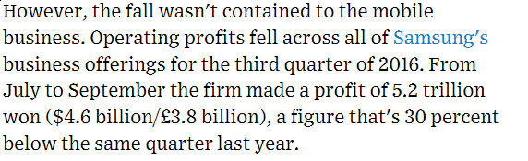
Clever marketing

Slide 15
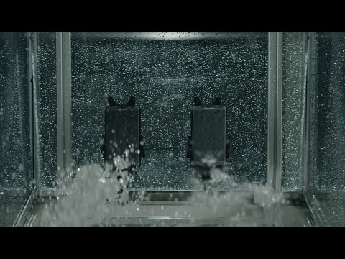
Clever marketing
Samsung have to convince customers that their products are safe so came up with this advert.
From the advert, what were the tests designed to imply.
Do we think Samsung does this with all their products?
https://www.youtube.com/watch?v=ek46zByrJVg

Slide 16
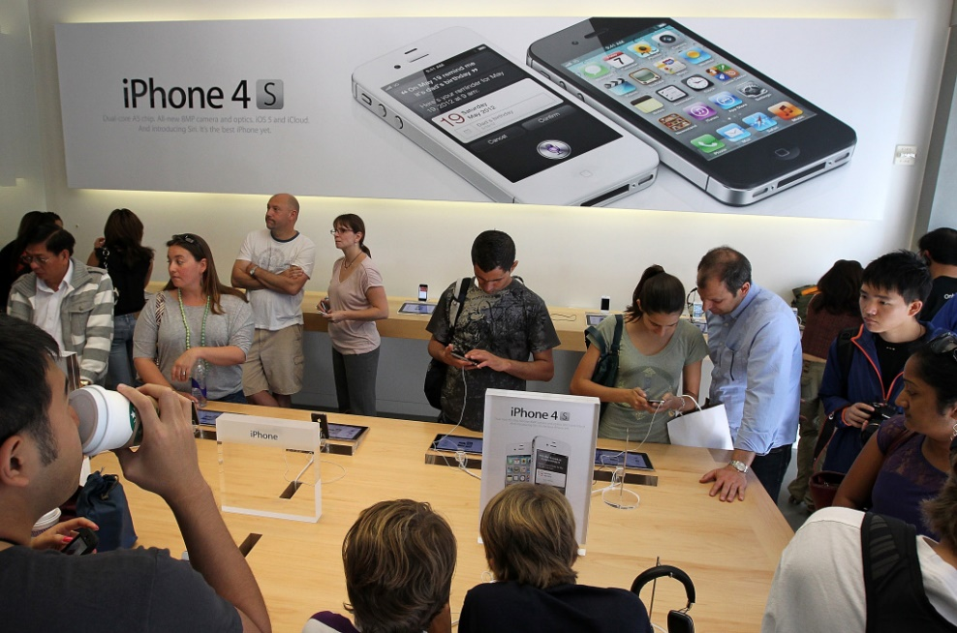
Product placement
PRODUCT PLACEMENT is the next step after a user trial.
Product Placement
Allows the design team to observe wider customer reaction.
Compare the reaction to competitors products (WOW factor).
Observe the performance when used by a customer.
Observe how easy consumers find the product to use.

Slide 17

Product placement
This sometimes happens in the high street where you would be invited in to try a product and answer some questions.
A design company could also place their product in a workplace so that it could be used beside similar products. The workplace would then feedback to the design company.
Product Placement is not seeing your product in a TV show or movie, like this clip from Wayne’s World.
https://www.youtube.com/watch?v=8lgLYGBbDNs

Slide 18
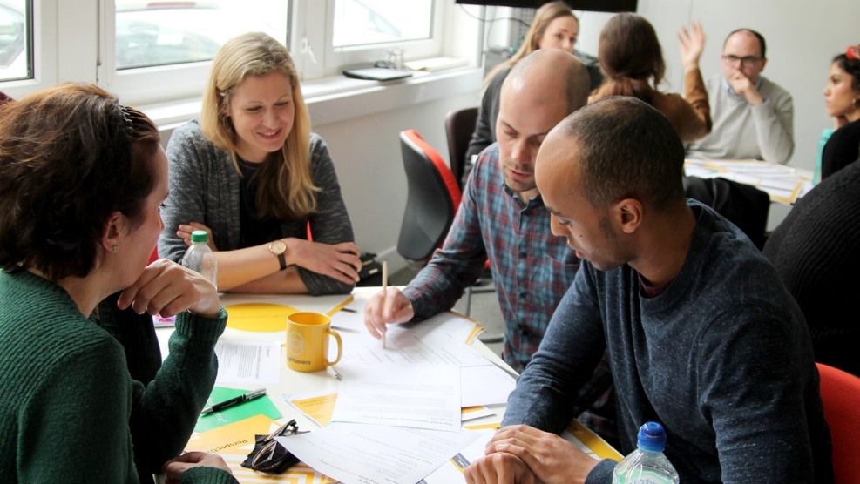
Concept testing
Concept tests are carried out with small groups who are part of the target market.
A prototype is not required, models or pictures are enough to allow potential users to decide if the product has potential.
Concept testing can be used to evaluate function, aesthetics and ergonomics.
The opinions of users from concept tests can be applied to estimate total numbers of sales.

Slide 19
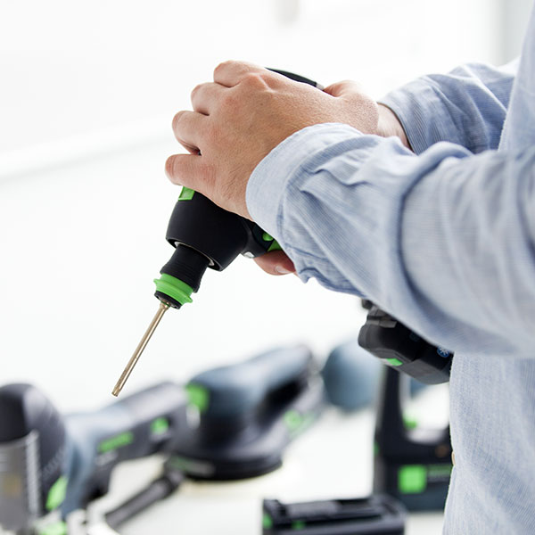
Expert testing
This method relies on the knowledge of recognised experts.
This method tests very specific aspects of a product.
For example, the expertise of an electronic engineer may be required to evaluate/test/assess any electronic components.
This method can be used to evaluate function, performance, ergonomics and materials.

Slide 20
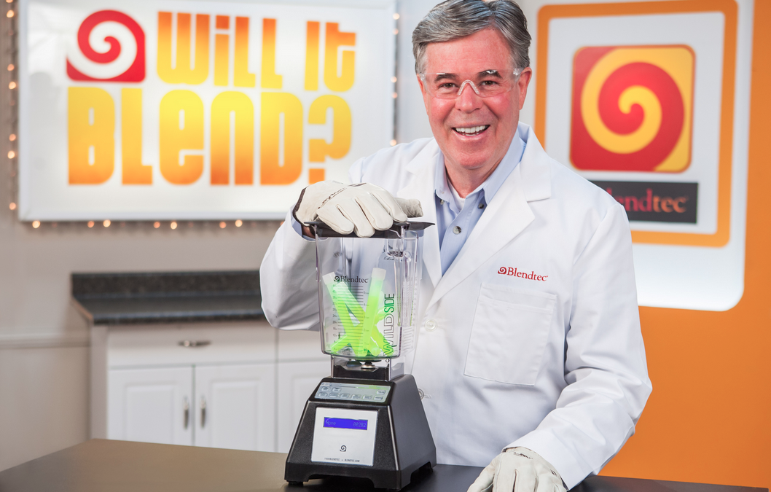
Product placement demonstrations
This method involves placing a product into its working environment.
This method allows designers to demonstrate how the product performs in its environment.
The aim is to generate interest in the product by setting it against competitors in the hope of generating a wow factor.
https://www.youtube.com/watch?v=lAl28d6tbko

Slide 21

Evaluation strategies
Questionnaires/Surveys
A questionnaire or a survey can be used to ASK the consumer what they want or what they think about a product.
They allow us to evaluate issues such as
  Customer satisfaction
  Market needs and wants
  Problems consumers have with products
  Potential development opportunities

Slide 22

questionnaires
To be an effective questionnaire, the questions you ask must allow the user to express an opinion.
  This means questions should avoid “YES” and “NO” type answers.
  Try to as “follow up” questions where they explain their answer or elaborate further. This should be optional.
  Ask the right questions for your research – avoid questions which do not inform your design development.

Slide 23
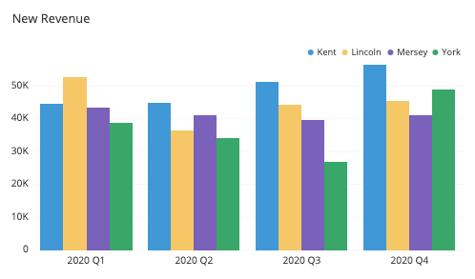
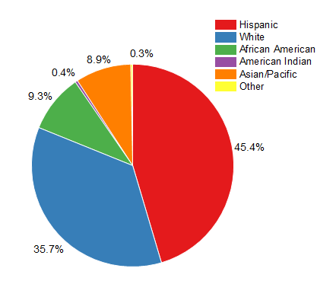
Presenting results
We need to collate and assess the results. Charts can be bar charts or if using percentages a pie chart

Slide 24
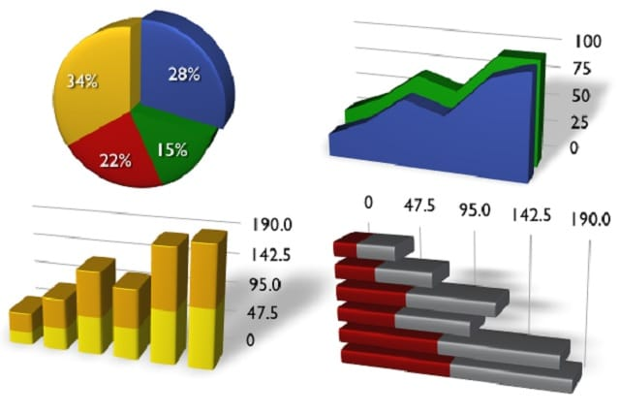
Presenting results
For each question we are going to create a chart to show the results. This allows us to quickly look at the information and then say something about the answer.
Charts can be completed by hand or using a computer program.
Example programs are shown below but you can use any program you are comfortable with:
  www.chartmaker.mathwarehouse.com/online-bar-graph-maker
  www.chartgo.com

Slide 25
evaluation
We have evaluated a subject of our choice. We also want to be able to evaluate products.
To do that we must evaluate using the design factors we talked about previously.
A
esthetics
Market
F
unction
E
rgonomics
Performance

Slide 26
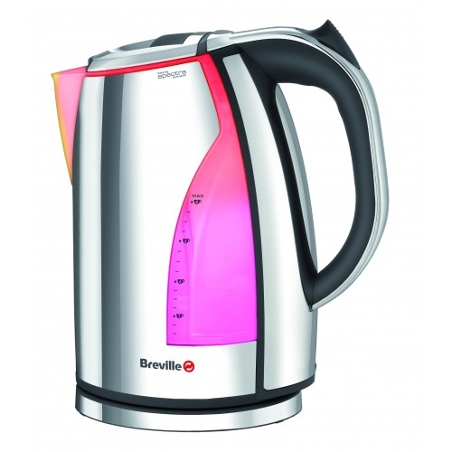
example
We are going to look more closely at a product now and how we can relate the design factors to that product.
Our product will be the kettle shown below:

Slide 27
market
What questions would we ask about this product in relation to the design factor of market? For example:
Who do you think this product is aimed at?
Circle from the age groups shown.
16-20
21-30
31-40
41-60

Slide 28
aesthetics
On a scale of 1 to 5, rate how interesting the shape of the product is.
1
Not very
Interesting
3
Interesting
5
Very
Interesting

Slide 29
function
On a scale of 1 to 5, rate how easy
the kettle was to fill.
1
Not very
Easy
3
Easy
5
Very
Easy

Slide 30
performance
How long did it take the kettle to boil its maximum volume.
1-2 mins
3-4 mins
5-6 mins
Longer than 6 mins

Slide 31
ergonomics
On a scale of 1 to 5, rate how easy
the kettle was to lift when filled to its maximum level.
1
Not very
Easy
3
Easy
5
Very
Easy

Slide 32
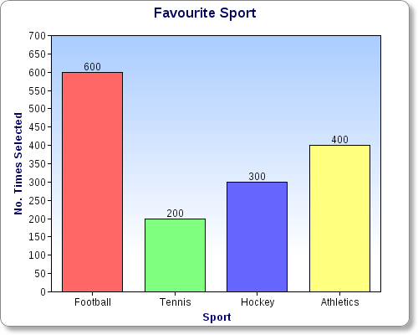
Recording results
Here is an example of how to present your results. Your graph should have
  Title
  Labelled Axis
  Scales
  Question you are trying to answer
  Description of results
I want to know what is the favourite sport for second year pupils in Boclair Academy.
I asked 1500 second year pupils what their favourite sport was from a provided list.
The results show that football was the favourite with athletics being second.

Slide 33
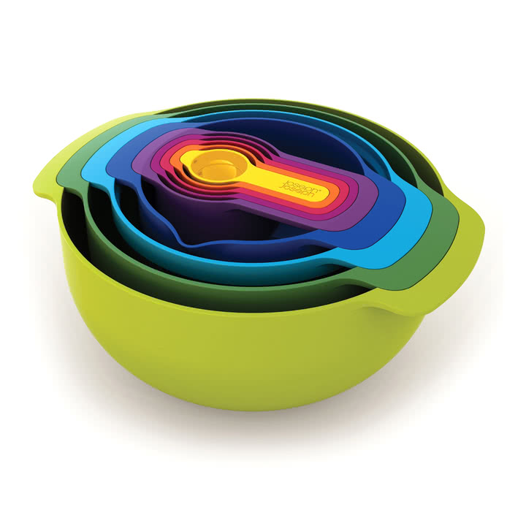
task
Your assessment task will require you to “Evaluate a familiar Product”
You will need to work out what product would be suitable.
Your product must be agreed with your teacher.
You will need to leave your product in school while carrying out this task.

